Slide 1
Canadian Victimization Rate Analysis
STAT4620 STAT5620 – Winter 2024
Team Member
Jinlei Xu B00884931 | Ye Wang B00972707 | Yuzhu Han B00819905
Xu Tong B00953793 | Xuelian Xi B00977221

Slide 2
Original Dataset Description
Data Source: Statistics Canada
 | Datasets Category | Description | Features | URL
01 | 1 Main dataset of Canadian Victimization Data | 131712 entities * 18 variables ⮕131712 entities * 6 variables | REF_DATE: Year GEO: Provinces Violation styles Gender of victim Age of victim Number of victimization | https://www150.statcan.gc.ca/t1/tbl1/en/tv.action?pid=3510005101
02 | 4 Supportive datasets of Canadian Census Data | 1. Population: 290934 entities * 16 variables ⮕ 5881 entities * 5 variables 2. Education: 71331 entities * 17 variables ⮕22206 entities * 5 variables 3. Low Income: 428400 entities *17 variables ⮕9282 entities * 5 variables 4. Unemployment: 5196798 entities * 19 variables ⮕ 1849 entities * 5 variables | REF_DATE: Year GEO: Provinces Gender Age Population with different educational attainment level Population of Low Incomce Percent of unemployed population | Population： https://www150.statcan.gc.ca/t1/tbl1/en/tv.action?pid=1710000501 Unemployment： https://www150.statcan.gc.ca/t1/tbl1/en/tv.action?pid=1410028703 Education： https://www150.statcan.gc.ca/t1/tbl1/en/tv.action?pid=3710013001 Low income： https://www150.statcan.gc.ca/t1/tbl1/en/tv.action?pid=1110013501
⮕：changes before and after pre-processing the datasets according to the research questions. Most of the deleted entities and variables are those non-relevant to the research questions and without the date range of the main dataset from 2009-2021.
Notes:
We have 5
We would like to see whether other factors, like population/education/low inomce rate/ unemployment rate of different areas will affect the victimization rate besides characteristics of victimse,e.g, victim's age and gender.

Slide 3
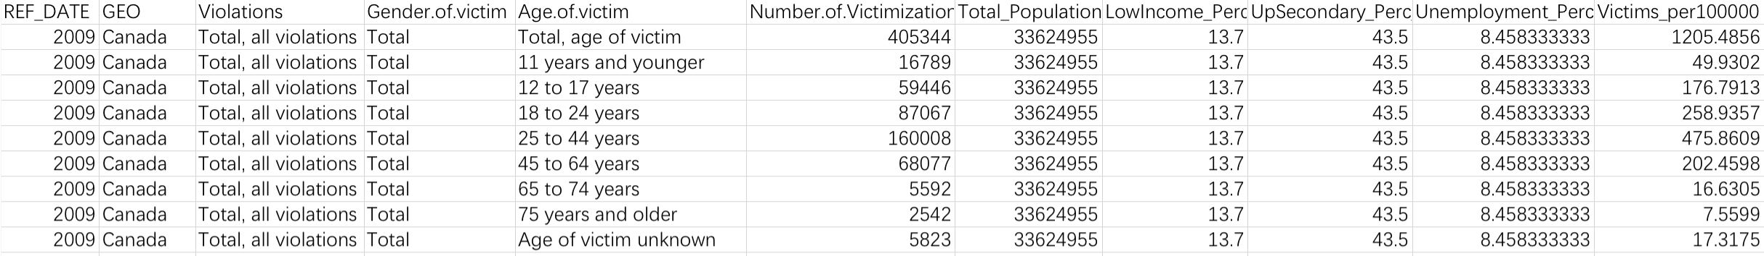
Processed Dataset Description
Cleaned and combined 5 datasets together according to REF_DATE(Year) and GEO(Locations)
Feature Enigeering：​
Deleted unrelated features and unreasonable values
Create new feature – Victim_per100,000, the ratio of number of victimization reports in 100,000 parts
Null Value dropped：​
​ 3 provinces have no values of 2 variables - Low Income and Unemployment from 2009-2021:​ Nunavut,
Northwest Territories and Yukong​​
Final dataset:
36,036 entities * 11 variables/features
Covering victimization and census data in 2009-2021, Canada Provinces+ Canada

Slide 4
Research Questions
01
What are the victim rates differences based on geographic characteristics?
02
Which victim’s characteristics is more correlated in different violations?
03
Which factors significantly affect victimization rates?

Slide 5
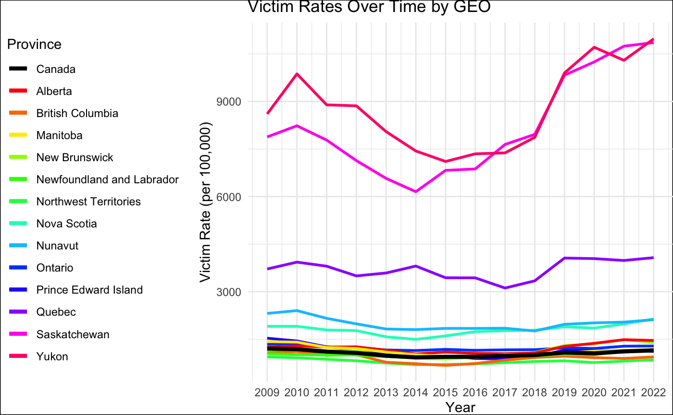
Analysis
RQ1: What are the victimization rates differences based on geographic characteristics?
Max: 10.974435%​
Min: 0%
The victim rates of Yukon, Saskatchewan, and Quebec are the highest.
Newfoundland and Labrador has the lowest victim rate.

Slide 6
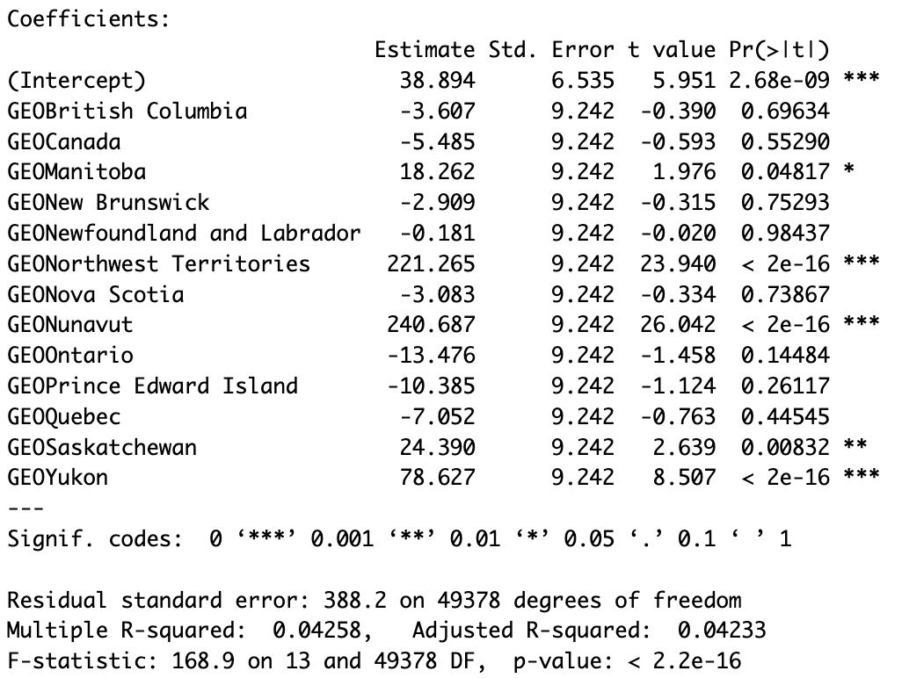
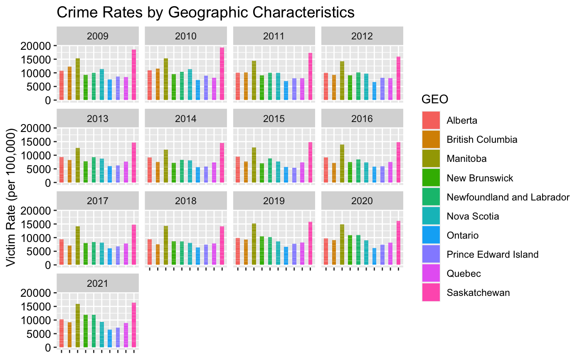
Analysis
RQ1: What are the victimization rates based on geographic characteristics?
Contrasts of victim rates among different provinces exist.
The victim rates from 2009 to 2012 are relatively steady.
2014/2017/2018/2020/2021 Quebec's victim rate decreased. Victim rates of Yukon and Saskatchewan increased. Why?
The relationship between different provinces and the victimization rate exists to some extent, but the explanatory power of the model is relatively weak.

Slide 7
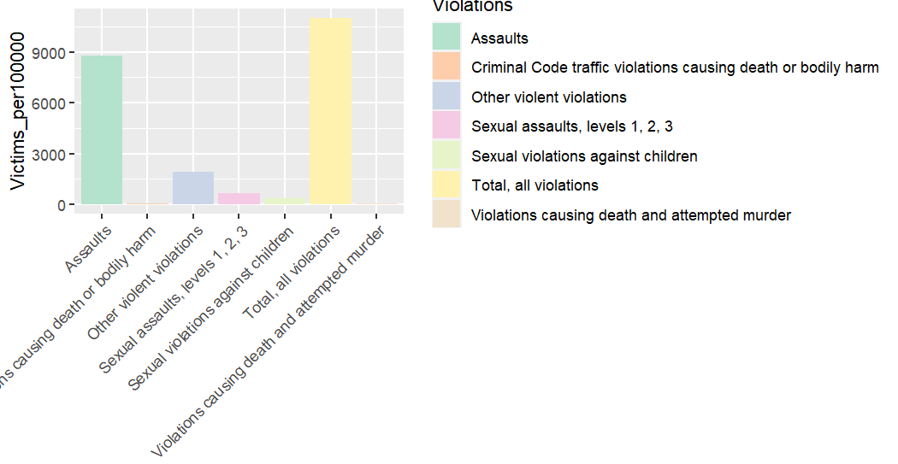
Analysis
RQ2: Which victim’s characteristics is more correlated in different violations?
In total, ‘Assaults’ is the most common type of crime in Canada.
(The reason need to be discovered in the next step)
‘Violations causing death and attempted murder’ is the most common type of crime in Canada.
(The reason need to be discovered in the next step)

Slide 8
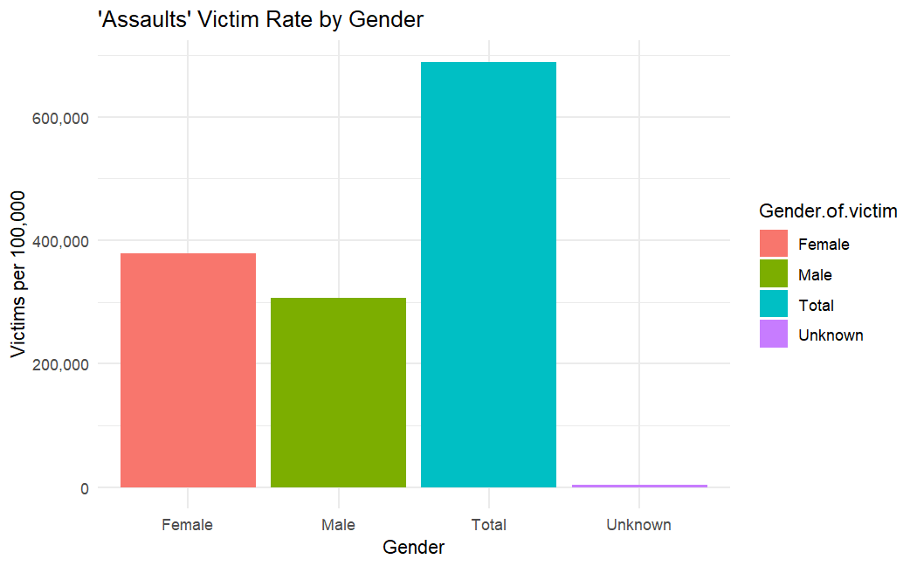
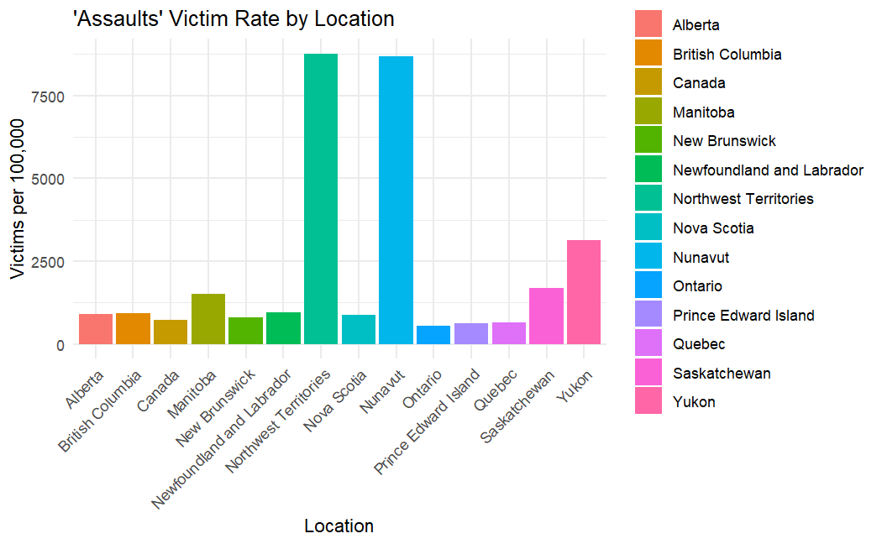
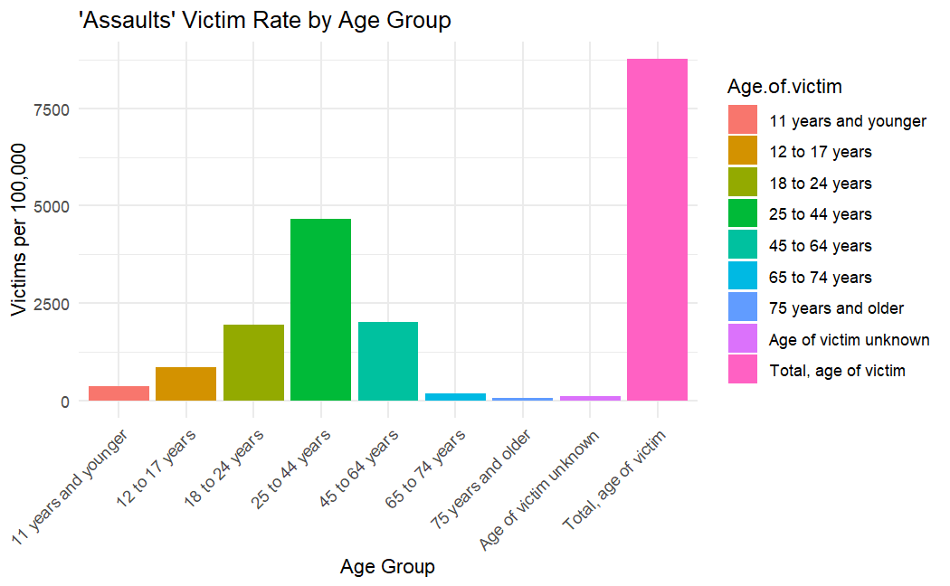
Analysis
RQ2: Which victim’s characteristics is more correlated in different violations?
Female victims encounter the assualts with higher rate.
Victims in Northwest and Nuvanut encounter the assualts with higher rate.
Victims from 25 to 44 years old encounter the assualts with higher rate.

Slide 9
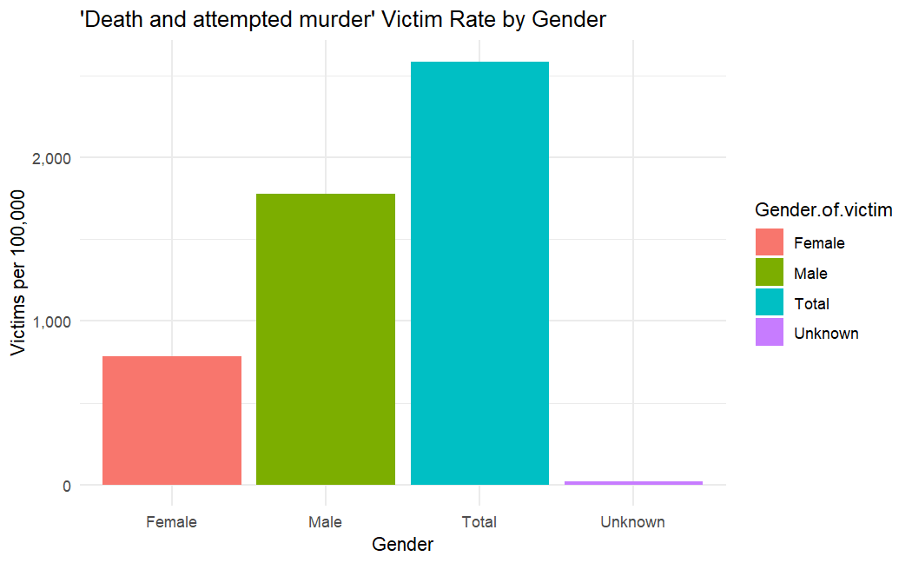
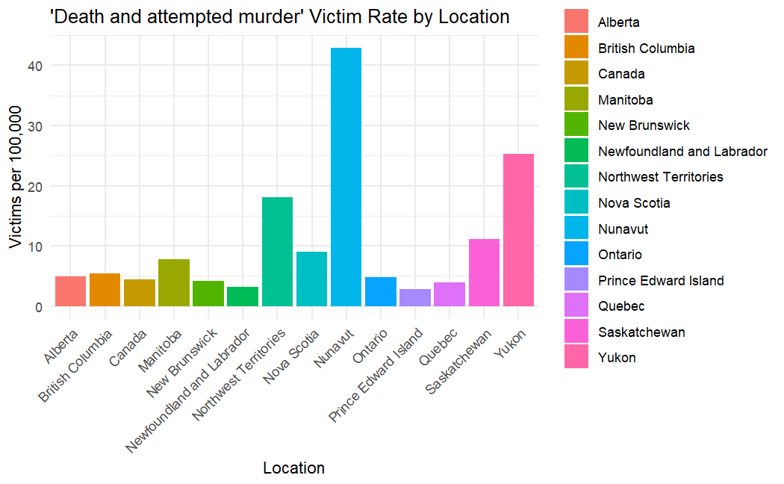
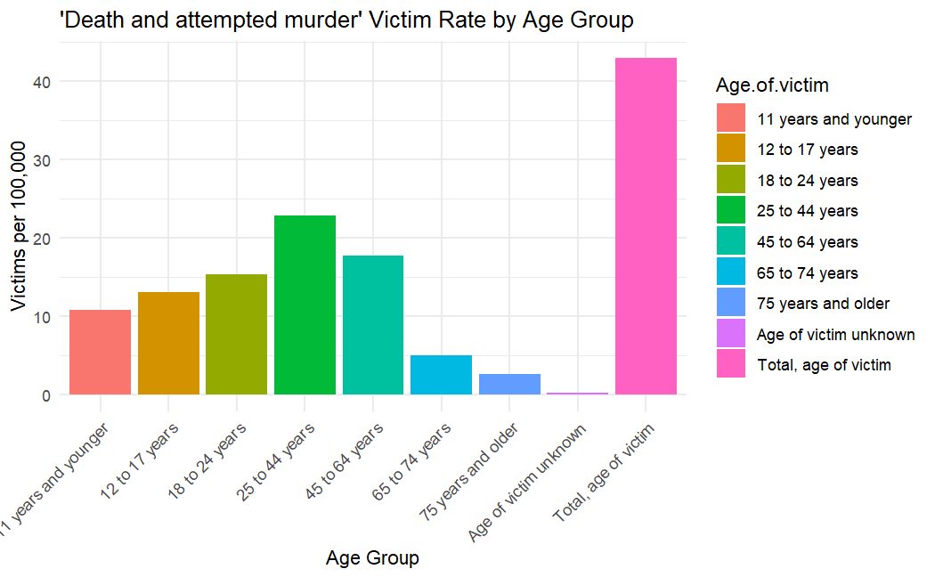
Analysis
RQ2: Which victim’s characteristics is more correlated in different violations?
Male victims encounter the death and attempted muder with higher rate.
Victims in Nuvanut encounter the death and attempted muder with higher rate.
Victims from 25 to 44 years old encounter the death and attempted muder with higher rate.

Slide 10
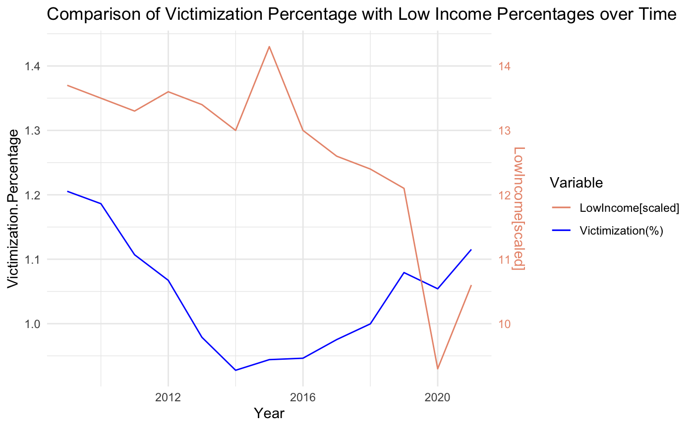
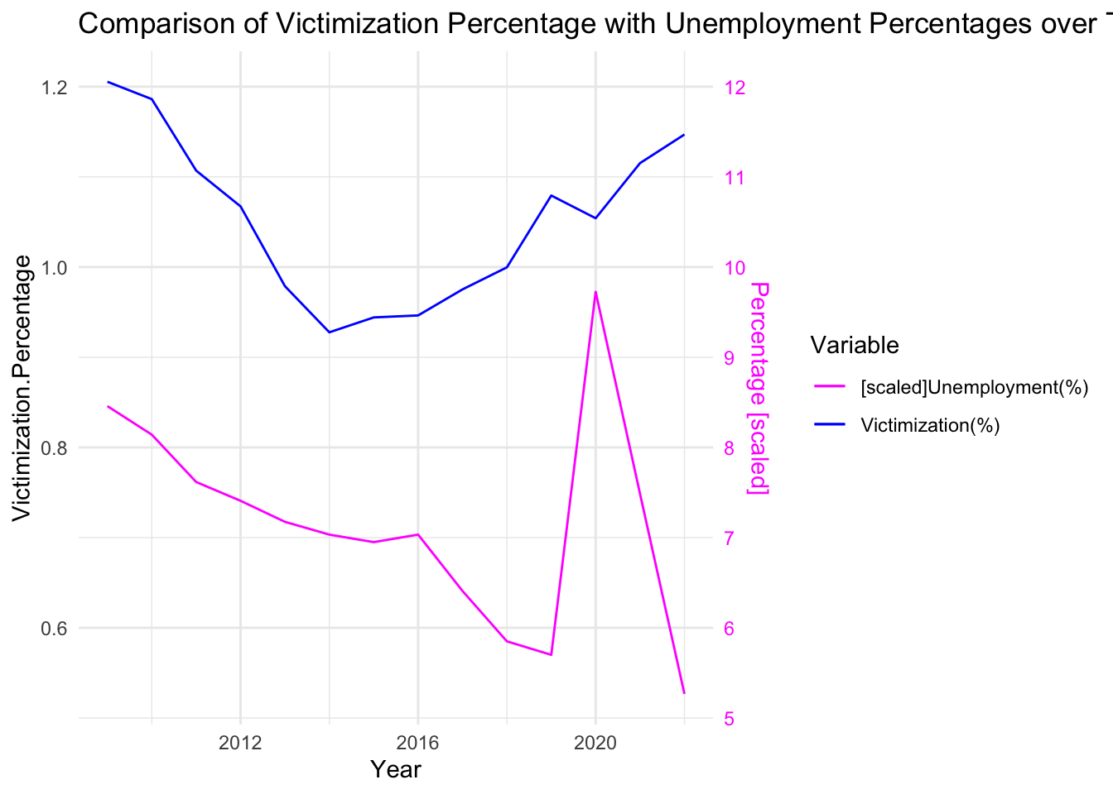
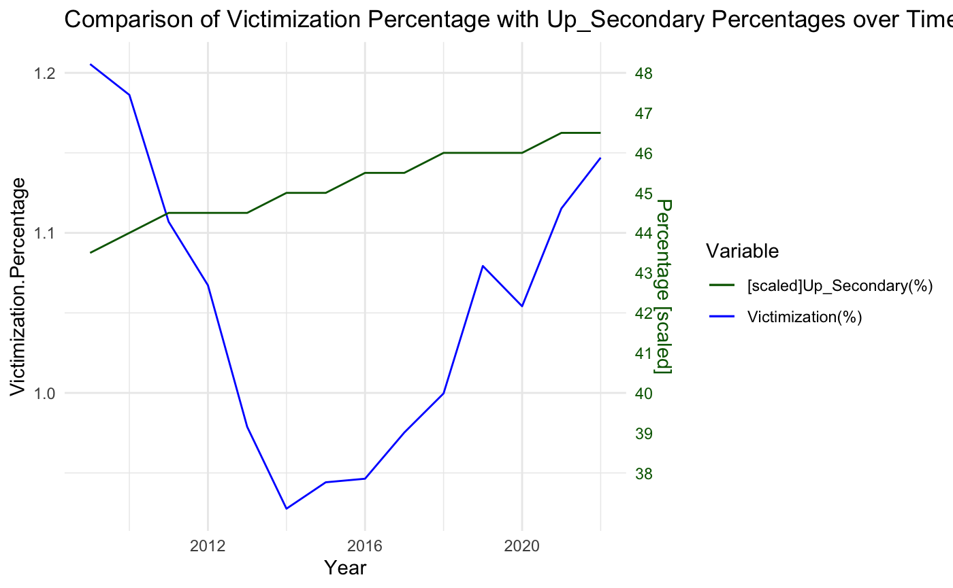
Analysis
RQ3: Which factors significantly affect victimization rates?
The victimization rate has no relationship with
the high school education rate or above in corresponding year
The victimization rate has some relationship with
the unemployment rate in corresponding year
the low income rate in corresponding year
Notes:
To delve into which factors affect victimization rate, first, we can focusing on what is victimization rate.
As we previously mentioned about numbers of victimization for specific year and province, and the population for those two corresponding factors.
The victimization rates is the ratio of the above two.
In our research factors, we assume the rate is related to those three factors below, the Low Income rate, the unemployment rate and the up secondary rate.
Then we get below three graphs...

Slide 11
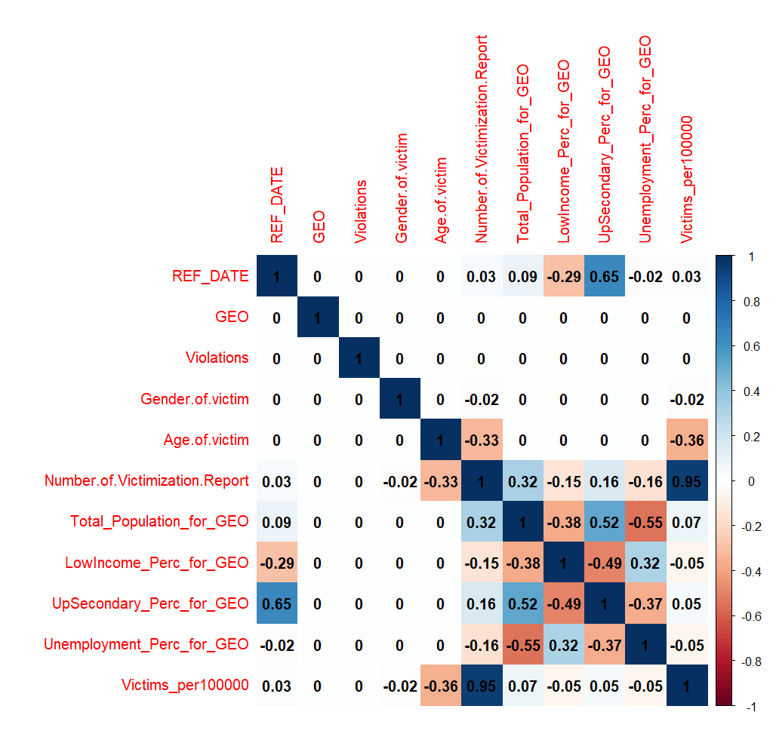
Analysis
RQ3: Which factors significantly affect victimization rates?
Confusion matrix- correlation between:
Education vs. Low income
Total population vs. Unemployment rate
Modelling:
Response variable characteristics: relatively small mean and large variance
Preferred model: Negative Binomial GLM
Remove the variable Number of victims to avoid potential problems

Slide 12
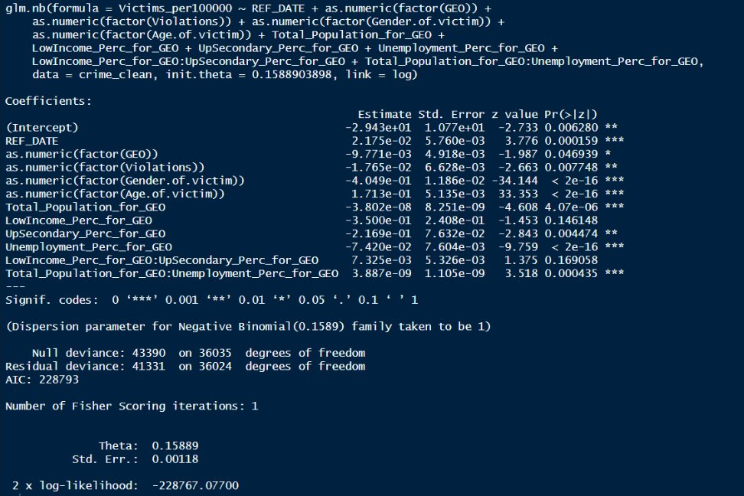
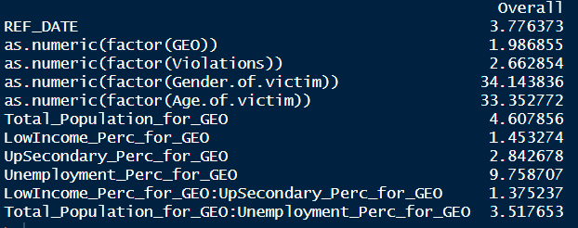
Analysis
RQ3: Which factors significantly affect victimization rates?

